Slide 1
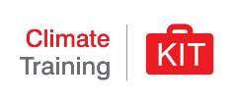
Climate change
and Water, Sanitation & Hygiene (WASH)
Pixabay
Notes:
Note: The ‘speaker notes to this presentation are comprehensive and provide background information to support preparation or reply to questions from trainees/trainers. It is not the intention that all information is presented in every session - so as facilitator, you could build a relevant story line depending on the audience and duration of the session. The intention is that the facilitators/trainers also adapt the pitch of the presentation to suit the audience and pre-existing technical knowledge.
The Red Cross Red Crescent Climate Centre was established in 2002 and became an independent foundation in 2004. We are the reference centre on climate change of the Red Cross Red Crescent family. The Climate Centre supports the Red Cross and Red Crescent Movement to understand and address the humanitarian consequences of climate change and extreme weather events.
The humanitarian mission of the Red Cross Red Crescent is to improve the lives of vulnerable people, and their health plays a central role. National Societies around the world are already grappling with emerging health challenges which are likely to be linked in some part to risks exacerbated by climate change and variability. Proactive health risk reduction strategies and programmes can be taken to reduce health related impacts particularly amongst the most vulnerable groups.

Slide 2
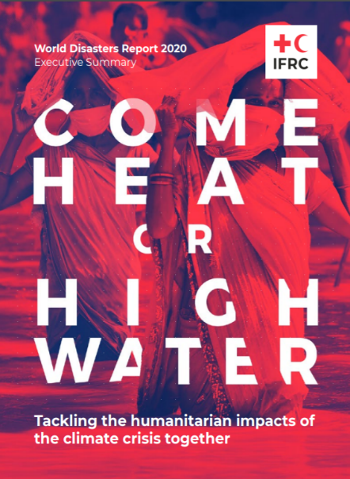
In the last decade:
1.7 billion people around the world have been affected by climate and weather-related disasters
Extreme weather- and climate-related disasters have killed more than 410,000 people
We still have a chance to act!
Notes:
Interaction: Can you guess how many people in the world are in need of humanitarian assistance currently? what are the projections for 2050 as a consequence of climate change related extreme weather?
Key talking points:
- The World Disaster Report 2020 published by the IFRC estimates that 1.7 billion people around the world have been affected by climate and weather-related disasters in the last decade.
- Another report published by IFRC (The COst of Doing Nothing) estimates that the number of people in need of humanitarian assistance in 2050 as a result of storms, droughts and floods could climb beyond 200 million annually compared to an estimated 108 million today = Doubling.
- It suggests that this doubling up of the need would come at a price, with climate-related humanitarian costs ballooning to US$ 20 billion per year by 2030 in the most pessimistic scenario. With no action, costs are likely to be higher.
- These findings confirm the current impacts of climate change, and will continue to have, on some of the world’s most vulnerable and marginalized people.
- The report highlights the chance to do something given the accelerated rate of change observed. Now is the time to take urgent action.
- By investing in climate mitigation, adaptation and disaster risk reduction, including through efforts to improve early warning and anticipatory humanitarian action, the world can avoid part of the impacts and costs.
- Determined and ambitious action NOW that prioritizes inclusive, climate-smart development could reduce the number of people in need of international humanitarian assistance annually to as low as 68 million by 2030, and potentially even further to 10 million by 2050 – a decrease of 90 per cent compared to today.
Additional information for the moderator:
- The Cost of Doing Nothing builds on the work and methodology of the World Bank’s Shock Waves report, and draws on data from the UN, the EM-DAT International Disaster Database as well as IFRC’s own disaster statistics.
- The Report presents potential consequences should the global community fail to step up ambition to address the rising risks of changing climate. It also highlights potential positive outcomes of action to strengthen resilience, adapt and address the current climate related health crises.
- World Disasters Report 2020: 'Come Heat or High Water: https://media.ifrc.org/ifrc/wp-content/uploads/2020/11/IFRC_wdr2020/20201113_WorldDisasters_0.pdf

Slide 3
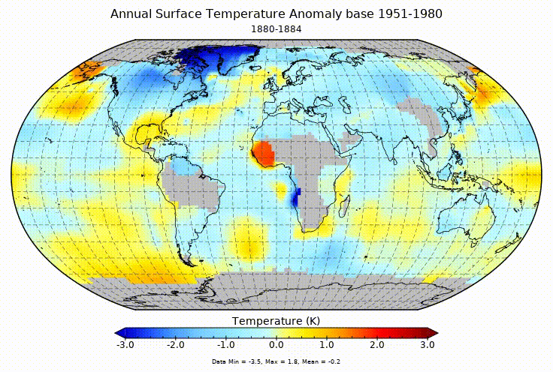
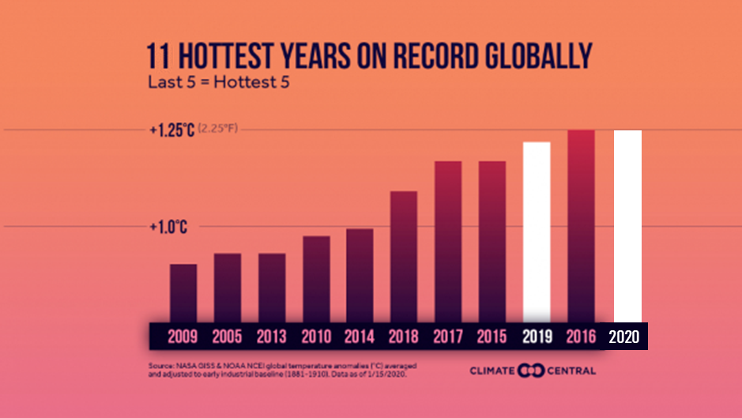
Scientists confirm that the problems are global
Source: NASA
Notes:
Interaction: What do we see here? can anyone summarise the graphic?
It is an illustration of the annual surface temperature anomaly based between 1951 and 2019, the blue color shows annual temperature below average, and the red color shows annual temperatures above average.
Key talking points:
One of the most vital indications of climate change is the steady increase in average global temperature over the past century.
The animation (from NASA) shows the 5-year mean temperature 1880-2017 – seen in relation to a “baseline" period 1951-1980.
Out of the hottest years recorded globally, 9 occurred between 2010-20, with 2016 and 2020 holding the highest records ever.
In 2020, 44th consecutive year that global temperature was above average
It is important to know that climate change is a global issue, but it is experienced very differently at the local level. For more information please refer to the 1a. Science and Impacts Presentation included in the CKT.
Last 11 hottest years: Data from NOAA/National Center for Environmental Information. Graphic from Climate Central.

Slide 4
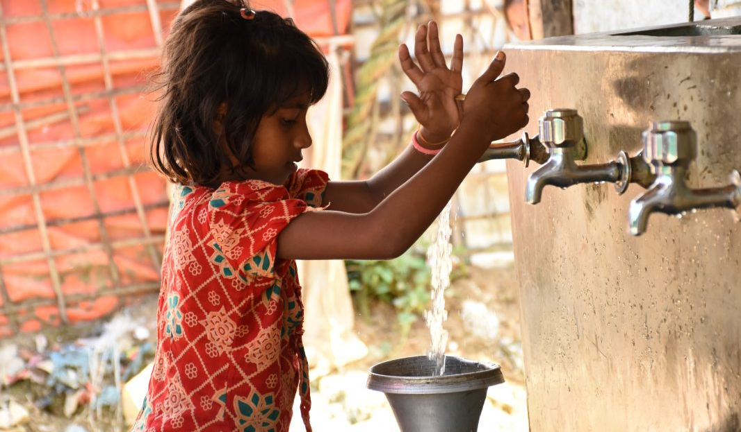
Photo: IFRC
Notes:
Interaction: Can someone give their view on whether they believe that climate change is a WASH and health crisis? Why?
Key talking points:
- Many people still think of climate change as an environmental issue, that might threaten polar bears but will not directly affect human health.
- However, the WHO has stated that "climate change is already impacting human health and has become the largest health crisis of our time" (WHO website 2019). It needs to be addressed both urgently and at global scale.
- There is substantial scientific evidence to support that climate change is already contributing to mortality and morbidity at the global level. A significant part of that burden is related to WASH services.
- Yet, only 0.5% of multilateral climate finance has funded health projects (WHO 2018).
- We need to shift the narrative and raise awareness that climate change is indeed a health and WASH crisis.
Additional information for the moderator:
There is higher certainty that climate related risks for health are rising. However there is also assiciated uncertainty about when and where these changes will happen and the magnitude of the impact. This is a complexity that we can not avoid.
According to the Lancet 2019 ‘Countdown report on health and climate change’: "Present day changes in heat waves, labour capacity, vector-borne disease, and food security provide early warning of the compounded and overwhelming impact on public health that are expected if temperatures continue to rise. Trends in climate change impacts, exposures, and vulnerabilities show an unacceptably high level of risk for the current and future health of populations across the world.

Slide 5
Climate change and WASH:
What will we cover?
LEARNING OBJECTIVES: By the end of this module, you should be able to:
Understand the public health risks associated with WaSH and climate change
Describe WASH related diseases and pathogens
Identify WASH interventions to reduce climate change impacts
Identify tools and resources on climate change and WASH
STRUCTURE
PART I - Health risks associated with WASH and climate change
PART II – Interventions to reduce health risk associated with WASH and climate change
PART III - Tools and Resources for WASH and climate change

Slide 6
Part I What are the health risks associated with WaSH and climate change?
Photo: IFRC
Notes:
What are the main health risks from WASH? Does Climate Change affect WASH, if yes how?
This question could be first posed as an open question to the audience to gather their thoughts.

Slide 7
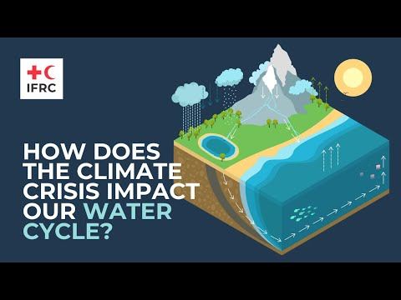
The water cycle
Notes:
Note, for the animator: this slide contains a link to a Youtube video, if you don’t have access to an internet presentation the next slide has the same content with an image instead.
https://www.youtube.com/watch?v=BgnB7KJqUbg&feature=youtu.be
Interaction: ask participants what do they know about the water cycle? How is it affected by climate change?
Talking points:
"The water cycle is the path that all water follows as it moves around Earth in different states", meaning liquid, gaz or ice (NASA)
Water evaporates from land and sea, which eventually returns to Earth as rain and snow.
The climate crisis intensifies this cycle because as air temperature increase, more water evaporates into the air.
Warmer air can hold more water vapor, which can lead to more intense rainstorms, causing major problems like extreme flooding around the world.
Meanwhile, some people are experiencing more dry air and even drought.
By affecting water resources, climate change also disrupts water services for all economic, social and environmental functions that water supports such as health, tourism, agriculture and industry.
Additional information for the facilitator - Sources: UN-Water - CC Adaptation - The pivotal role of water, 2010, UN - World Water Development Report 2020 - Water & Climate Change
The earth’s climate and the terrestrial water cycle have a very close and complex relationship that are also mediated by anthropogenic factors such as water management systems or agriculture.
"Water is the primary medium through which climate change influences the Earth’s ecosystem and thus the livelihood and well-being of societies" (UN-Water - CC Adaptation - The pivotal role of water, 2010).
Rainfall comes from seawater evaporation that creates clouds that are pushed over land by wind currents. Some of that rain will be absorbed by the soil and fuel groundwater aquifers, some of it will get captures into rivers and lakes and fuel surface water, and eventually all of that water will end up back in the oceans.
Plants play a crucial role since they contribute in retaining water in land and release the water that they are not using back into the atmosphere through what is called “evapotranspiration”. This contributes to forming clouds and also explains why there is rain even far away from the ocean shores. This is also why deforestation is associated with an increase in droughts.
Water is the primary medium through which climate change influences the Earth’s ecosystem and thus the livelihood and well-being of societies (UN-Water 2010). The earth’s climate and the terrestrial water cycle have a very close and complex relationship that are also mediated by anthropogenic factors such as water management systems or agriculture. Changes in climate variability and change therefore affects water resources. For example, a rainfall deficit will reduce soil moisture, river flow and groundwater recharge, but the magnitude of these flow-on effects will depend on local conditions such as soil properties, geology, vegetation and water use. By affecting water resources, climate change also disrupts water services for all economic, social and environmental functions that water supports. Therefore, the impacts reach into many sectoral interests such as health, tourism, agriculture and industry.
Water-related climate risks arise from too much water, too little water or polluted water.
Source: IFRC

Slide 8
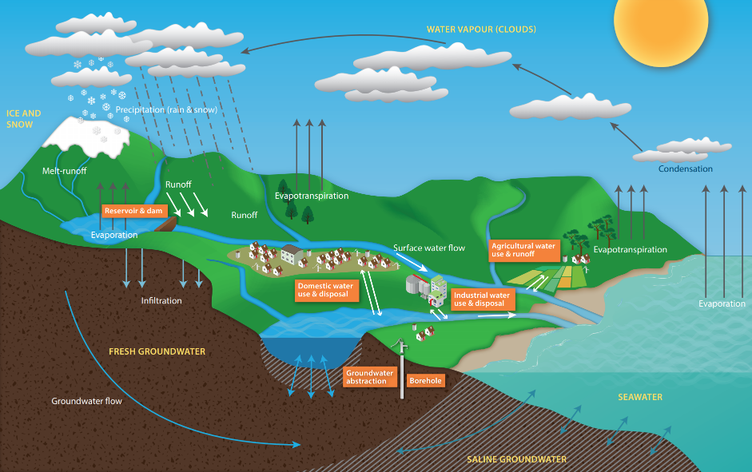
The water cycle
Source: un-igrac
Notes:
Interaction: ask participants what do they know about the water cycle? How is it affected by climate change?
Talking points:
"The water cycle is the path that all water follows as it moves around Earth in different states", meaning liquid, gaz or ice (NASA)
Water evaporates from land and sea, which eventually returns to Earth as rain and snow.
The climate crisis intensifies this cycle because as air temperature increase, more water evaporates into the air.
Warmer air can hold more water vapor, which can lead to more intense rainstorms, causing major problems like extreme flooding around the world.
Meanwhile, some people are experiencing more dry air and even drought.
By affecting water resources, climate change also disrupts water services for all economic, social and environmental functions that water supports such as health, tourism, agriculture and industry.
Additional information for the facilitator - Sources: UN-Water - CC Adaptation - The pivotal role of water, 2010, UN - World Water Development Report 2020 - Water & Climate Change
The earth’s climate and the terrestrial water cycle have a very close and complex relationship that are also mediated by anthropogenic factors such as water management systems or agriculture.
"Water is the primary medium through which climate change influences the Earth’s ecosystem and thus the livelihood and well-being of societies" (UN-Water - CC Adaptation - The pivotal role of water, 2010).
Rainfall comes from seawater evaporation that creates clouds that are pushed over land by wind currents. Some of that rain will be absorbed by the soil and fuel groundwater aquifers, some of it will get captures into rivers and lakes and fuel surface water, and eventually all of that water will end up back in the oceans.
Plants play a crucial role since they contribute in retaining water in land and release the water that they are not using back into the atmosphere through what is called “evapotranspiration”. This contributes to forming clouds and also explains why there is rain even far away from the ocean shores. This is also why deforestation is associated with an increase in droughts.
Water is the primary medium through which climate change influences the Earth’s ecosystem and thus the livelihood and well-being of societies (UN-Water 2010). The earth’s climate and the terrestrial water cycle have a very close and complex relationship that are also mediated by anthropogenic factors such as water management systems or agriculture. Changes in climate variability and change therefore affects water resources. For example, a rainfall deficit will reduce soil moisture, river flow and groundwater recharge, but the magnitude of these flow-on effects will depend on local conditions such as soil properties, geology, vegetation and water use. By affecting water resources, climate change also disrupts water services for all economic, social and environmental functions that water supports. Therefore, the impacts reach into many sectoral interests such as health, tourism, agriculture and industry.
Water-related climate risks arise from too much water, too little water or polluted water.
Source: https://www.un-igrac.org/resource/water-module-poster-water-cycle-including-human-activity

Slide 9
How does climate change affect the water cycle?
Water availability, access
Water quality
Water systems
Increased risks of flooding and drought in many areas
Water supplies stored in glaciers and snow cover are projected to decline
Increased competition between WaSH and agriculture
Increased water temperatures are projected to exacerbate water pollution
Saline intrusion of coastal aquifers from rise in sea levels
Climate change affects the existing water infrastructure and water management practices
Climate change challenges the traditional assumption that past hydrological experience provides a good guide to future conditions
Globally, the negative impacts of future climate change on freshwater systems are expected to outweigh the benefits
Notes:
Interaction: Can you guess how climate change affects (while in presentation mode, the text in each box will appear after clicking)
Water availability & stress?
Water quality?
Water systems?
As mentioned in a previous slide, there is already a WASH crisis. Climate change is not creating it but making it worse.
As a result of climate change, water is expected to decrease in availability and quality. We will explore this further in the next slides.

Slide 10
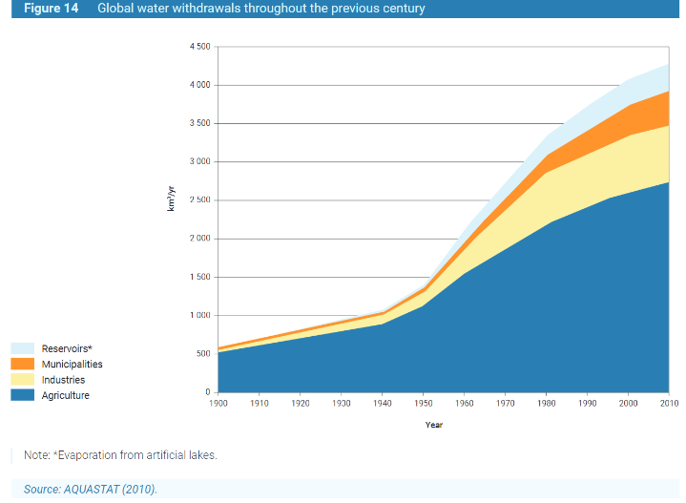
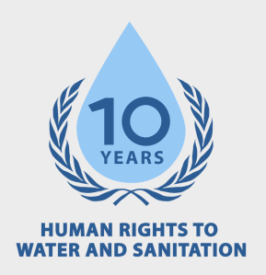
Water availability & stress
Notes:
Interaction: Is your country / region already affected by water-stress? If so, can you already feel the impact of climate change? If not, do you think it will be affected by water stress in the future?
Talking points:
As we mentioned previously, access to water has been recognized as a human right by the United Nations since 2010.
Climate change is projected to increase water stress and disrupt water availability by increasing rainfall in certain regions and decrease it in others (IPCC, 2018).
On the other side, water demand is increasing twice as fast as population growth for the last century (FAO, 2013). That means that water demand is generated not only by population growth but by other factors as well such as socio-economic development and changing consumption patterns.
70% of the water consumed on Earth is used by agriculture for irrigation.
Water sources become scarcer and more uncertain while consumption keeps increasing, which creates a “scissors effect”: water stress will be exacerbated in regions where it is already present, and it will also start affecting regions where water is currently abundant.
Water stress is associated with negative health outcomes, limitations to economic growth opportunities can can also fuel migration and conflict (for more information on that please consult the specific module on Climate Change & Migration)
Additional information for the facilitator - Source: UN - World Water Development Report 2020 - Water & Climate Change (p.30) https://unesdoc.unesco.org/ark:/48223/pf0000372985/PDF/372985eng.pdf.multi
Water availability & stress
Changes in precipitation and temperature will directly affect the terrestrial water budget (Schewe et al., 2014). Evaporation from the land surface is expected to increase as a result of the global trend of rising air temperatures (except in the driest regions, where the lack of water prevents such an increase). This increase may be offset by an increase in precipitation, but in many regions and especially in those areas where rainfall volumes will decrease, this leads to decreasing streamflow volumes and a decrease of water availability in different seasons (IPCC, 2018).
The combined effect of changes in precipitation and evaporation will impact soil moisture and groundwater, making droughts more frequent and severe in certain regions.
Climate change is also projected to cause a reduction in snow cover, glacier and permafrost (IPCC, 2019, high confidence). This will negatively affect water resources of mountain regions and their adjacent lowlands.
Although 75% of the surface of the Earth is covered with water, less than 3% of the global water is freshwater, and only 1/3 of that is liquid - the rest is captured in icecaps and glaciers. That means that only 1% of the global water supplies is easily available fresh water → We have a lot of water on Earth, but there is not much we can use for drinking or agriculture.
97% of the water present on our planet is seawater, which cannot be used for agriculture purposes because it is salty.
Freshwater represents only 3% of the global water supplies, 70% of which is frozen. As a result, the freshwater available for domestic use, agriculture and industry represents less than 1% of the global water resources → We have a lot of water on Earth, but there is not much we can use for drinking or agriculture.
According to UN Water, water use has been increasing worldwide by about 1% per year since the 1980s, driven by a combination of population growth, socio-economic development and changing consumption patterns.
On the one hand, a growing population, rising income and changing consumption patterns are projected to increase water demand at the global level. Global warming will further exacerbate this trend, as water demand tends to increase with temperature (Gato et al., 2007).
On the other hand, variations in water availability and quality due to changes in precipitations and temperatures are projected to make water supplies more erratic and uncertain.
That “scissors effect” is likely to increase the pressure on water resources.
The World Water Assessment Programme (WWAP - UNESCO) estimates that “regardless of the magnitude of future global, and more importantly local, water deficits, water scarcity is likely to limit opportunities for economic growth and the creation of decent jobs in the coming decades”. Water scarcity also contributes in fueling migration and conflict.

Slide 11
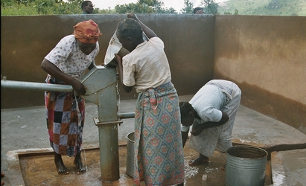
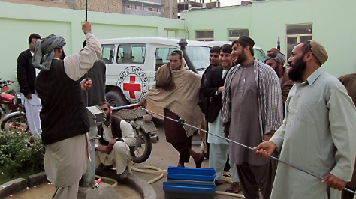
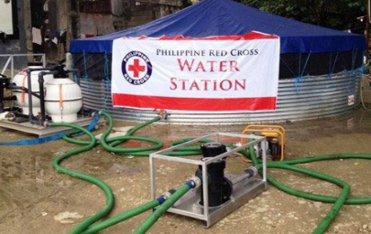
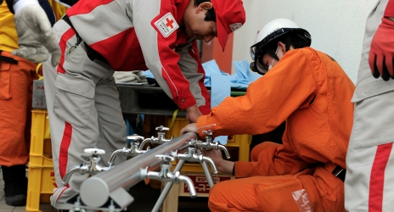
Access: physical and economic
Photo: IFRC
Photo: ICRC
Photo: Philippines Red Cross
Photo: IFRC
Notes:
Interaction: Can you explain the difference between economic and physical water scarcity? Is your country affected by any of them?
Talking points:
Projections of the needs for water security investment diverge, but they all indicate that massive investment is needed in order to achieve the Sustainable Development Goal related to access to safe Water & Sanitation. Investment needs will be exacerbated by climate change.
In some regions water scarcity can be physical, due to excessive withdrawals or to natural aridity (ex: Australia, Central Asia, Middle East and North Africa, Northern China, and Southern Africa). In others, water scarcity is economic, which means that it is caused by a lack of water infrastructure (ex: some parts of Africa, South America and South Asia). Developing more water infrastructure in these regions is the only way to alleviate scarcity, but it should take into account the impacts of climate change that are already observed (or are likely to occur).
Climate change puts water and sanitation infrastructure at higher risk. For example, water and wastewater infrastructure in coastal low-lying cities are more prone to severe flooding (Cain, 2017).
Additionally, many drinking-water treatment plants, particularly small ones, are not designed to handle the more extreme influent variations expected with climate change.
Additional information for the facilitator - Source: UN - World Water Development Report, 2020)
"Projections of the needs for water security investment diverge, but they all indicate that the scale of investment ought to increase significantly in order to achieve the Sustainable Development Goal related to access to safe Water & Sanitation. Investment will need to be channelled into creating the appropriate water infrastructure in developing countries, and targeted at upgrading existing, and sometimes aging, infrastructure in advanced economies."
Economic water scarcity is normally caused by a lack of water infrastructure that can ensure access to water (Comprehensive Assessment of Water Management in Agriculture, 2007), and occurs typically in Africa and some parts of South America and South Asia. Developing more water infrastructure in these regions is the only way to alleviate scarcity, but it should take into account the impacts of climate change that are already observed (or are likely to occur). Physical water scarcity, on the other hand, due to excessive withdrawals and well-developed infrastructure for human use or due to natural aridity, typically occurs in Australia, Central Asia, Middle East and North Africa, Northern China, and Southern Africa.
Many drinking-water treatment plants, particularly small ones, are not designed to handle the more extreme influent variations expected with climate change. These demand additional or different infrastructure, which renders water treatment very costly, particularly in rural areas (WHO - Climate Resilient Water Systems, 2018). As a result, climate change is expected to exacerbate water quality decline in many regions.
Images:
1 - IFRC: https://www.ifrc.org/es/noticias/noticias/africa/malawi/in-malawi-water-is-life/
2 - ICRC: https://www.icrc.org/sites/default/files/styles/document_main/public/document/image/afghanistan-water-committee_0.jpg?itok=hMNMaEhc
3 - Philippine RC: http://aidmatrixfoundation.blogspot.com/2013/11/techsoup-typhoon-haiyan-how-to-help.html
4 - IFRC:
https://www.ifrc.org/en/news-and-media/news-stories/asia-pacific/japan/japan-hand-washing-alone-can-prevent-most-water-related-diseases-51201/

Slide 12
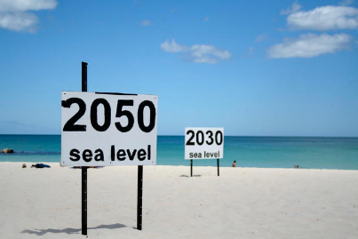
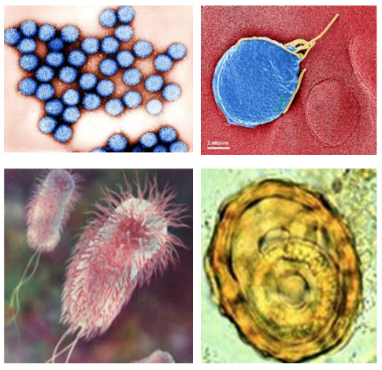
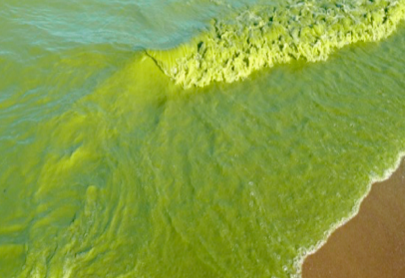
Water quality
Photo: Julie G / Flickr
Source: waterpathogens.org
Source: UN Environment Program
Source: UN Environment Program
Notes:
Interaction: can you think of potential ways in which watre quality may be affected? Do you think there is a link between sea-level rise and water quality in coastal areas?
Talking points:
The world’s freshwater resources are increasingly polluted with organic waste, pathogens, fertilizers and pesticides, heavy metals, and emerging pollutants.
Disasters such as flooding are associated with contamination of drinking water sources.
Rising temperatures contribute to that issue because warmer waters are often better suited for pathogen development.
Pathogen contamination is the most widespread water quality problem in developing countries due to unsafe water and sanitation (WHO/UNICEF, 2017).
Climate change is also projected to cause sea-level rise, which will put some fresh water sources in coastal areas at higher risk of contamination ( high salinity).
Additional information for the facilitator - Source: UN - World Water Development Report 2020 - Water & Climate Change (p.30)
Water quality
Emerging pollutants present a new global water quality challenge in both developed and developing countries, with potentially serious threats to human health and eco-systems.
https://www.flickr.com/photos/go_greener_oz/3046225225/in/photostream/

Slide 13
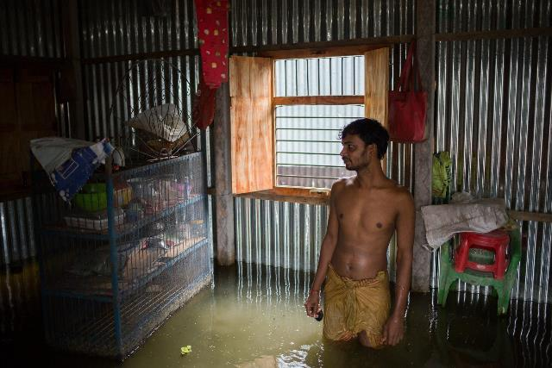
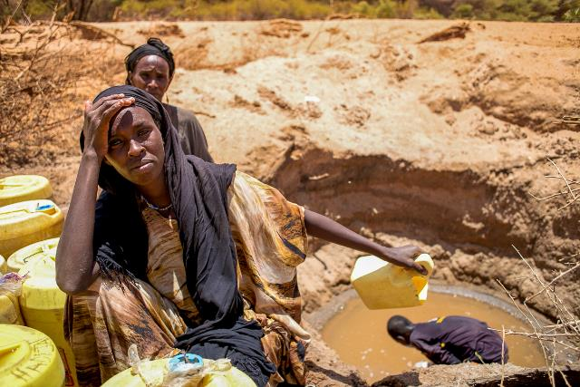
Excess: water-related disasters
Photo: Bangladesh Red Crescent
Photo: D. Onyoidi / KRCS
Notes:
Optional
Interaction: Can you think of water-related disasters? (in presentation mode the pictures will appear after a click)
Talking points:
The two main water-related disasters are floods and drought. During the past 20 years, they have caused more than 166,000 deaths, affected another three billion people and caused total economic damage of almost US$700 billion (EM-DAT, 2019).
Global floods and extreme rainfall events have surged by more than 50% this decade, and are now occurring at a rate four times higher than in 1980.
Changes in precipitation patterns under climate change conditions are expected to increase the intensity and frequency of flood and drought events in many regions (Hirabayashi et al., 2013; Asadieh and Krakauer, 2017).
The impacts and costs of these events are exacerbated by such factors as unplanned urbanization and degradation of ecosystem services (UN-Water).
Additional information for the facilitator - Source: UN - World Water Development Report 2020 - Water & Climate Change

Slide 14
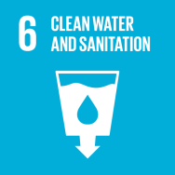
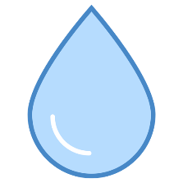
WASH is a Health and a development issue
Sustainable Development Goals
Notes:
Interaction: Can you think of which of the 17 sustainable development goals may be linked to hygiene and sanitation?
Can you guess how many people were not able to wash their hands at home in the context of the COVID-19 pandemic?
Talking points:
Water, Hygiene and Sanitation (WaSH) are interconnected.
Ensuring access to clean water and sanitation is part of the Sustainable Development Goals (SDGs). The progress of this objective contributes to the progress of other objectives mainly related to health, education, economic growth, gender equality and the environment.
Access to water and sanitation services have been recognized by the United Nations as a specific human right in 2010.
While substantial progress has been made in increasing access to clean drinking water and sanitation, billions of people—mostly in rural areas—still lack these basic services.
With the COVID pandemic we have also been surprised by the fact that 3 billion people around the world remain unable to wash their hands at home. 44% of schools lack hand-washing facilities and 45% of health care facilities in underdeveloped countries lack basic water services.
One of the most important recent milestones has been the recognition by the United Nations general assembly in 2010 of the right of all human beings to have access to a sufficient amount of water for domestic and personal use:
Everyone has the right to between 50 and 100 litres of safe water per day.
The cost of water should not exceed 3% of household income
The water source should be physically accessible: within 1000 meters of the home and its collection should not exceed 30 minutes
WASH is highly vulnerable to climate change, which makes achieving SDS 6 even more difficult. There is already a WASH crisis, billions of people do not have access to basic water, sanitation and hygiene services. Climate change is making that crisis worse, as we will see in the presentation.
Additional information for the facilitator - Source: WHO - Health Environments for Healthier Populations
7/10 people used safely managed drinking water services in 2015. The remaining 3 used sources defined as basic (17%), limited (4%) or surface water (2%) → 2 billion people drinking water contaminated with faeces.
2/5 people used safely managed sanitation services in 2015. The remaining 3 used sanitation defined as basic sanitation (29%), open defecation (12%), unimproved (12%) or limited sanitation (8%) → About 432 000 diarrhoea deaths were caused by inadequate sanitation, including 153 000 children aged under 5 years
Only 26% of the world’s population was estimated to wash hands after contact with excreta → An estimated 165 000 diarrhoea deaths were caused by inadequate hygiene.
Two out of five people do not have a basic hand-washing facility with soap and water (https://data.unicef.org/resources/handwashing-data-covid-19-response/)

Slide 15
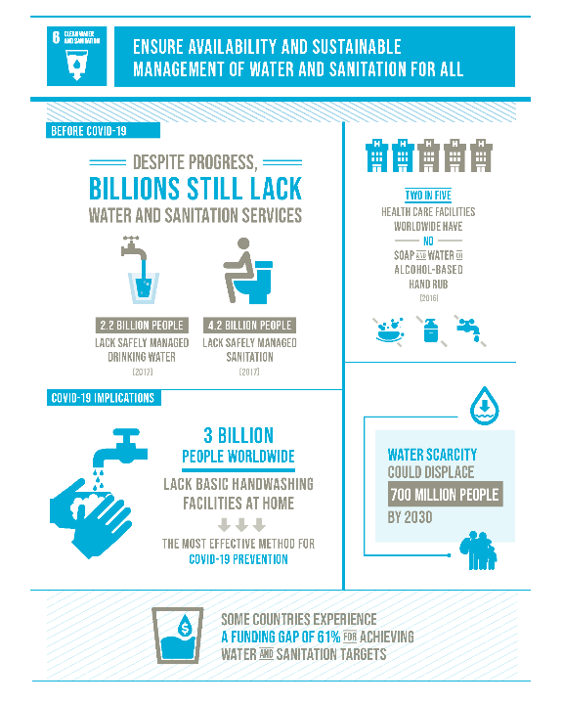
Sustainable
Development
Goal 6
Source: https://sdgs.un.org/goals/goal6
Notes:
Source: https://sdgs.un.org/goals/goal6

Slide 16
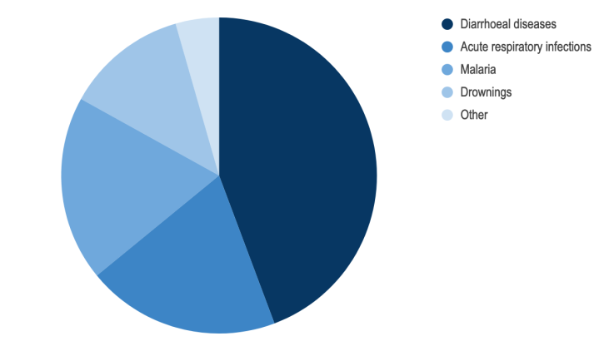
Disease burden from inadequate WASH for the year 2016
Notes:
Interaction: Can you guess what are the WaSH-related health risks that are causing the highest number of deaths?
The graph has the following disease burden, can you try to order them from the higher to the lowest? (the graph legend will appear with animation)
Acute respiratory infections
Diarrhoeal diseases
Drownings
Malaria
This graph if from 2016, it does not include WASH-related COVID-19 death. As mentioned, lack of access to safe drinking water and sanitation is contributing to the current pandemic, although it was not yet quantified.
Talking points:
The WHO estimates that inadequate water and sanitation causes at least two million preventable deaths worldwide annually with the greatest burden falling on children under five
44% of those deaths are attributable to diarrheal diseases: this is where we should focus our efforts.
"Since 2000, progress on mortality associated with all major water- and sanitation-related diseases has shown an encouraging downward trend (WHO, n.d.) commensurate with advances in access to improved water supply and sanitation" (UN - World Water Development Report 2020 - Water & Climate Change)
"However, morbidity has been slower to decline and, in many regions, the social and economic burden of inadequate water, sanitation and hygiene (WASH) lies disproportionately on women and girls (e.g. lost opportunities for work or education due to water collection tasks or shame and anxiety about toilet use and menstrual hygiene management) (Wendland et al., 2017)" (UN - World Water Development Report 2020 - Water & Climate Change)
Additional information for the facilitator - Source: (UN - World Water Development Report 2020 - Water & Climate Change)
Inadequate water and sanitation have been conservatively estimated to cause nearly two million preventable deaths worldwide annually with the greatest burden falling on children under five (WHO, 2019a). Most of those those are attributable to the following diseases (figures from WHO for year 2016)
Diarrhoeal diseases: 44%
Acute respiratory infections: 20%
Malaria: 19%
Drowning: 12.5%
Other including dengue, malnutrition, etc. only represents less than 5%

Slide 17
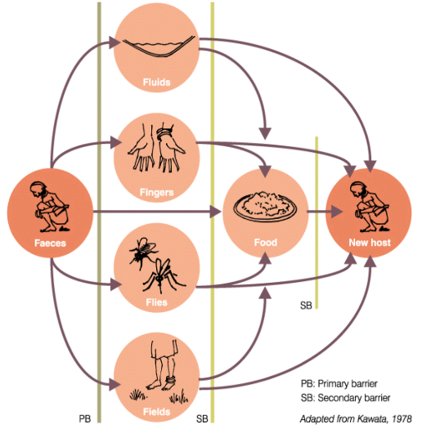
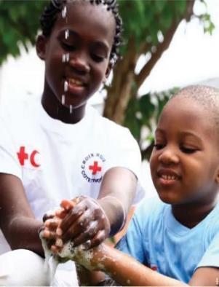
WASH and diarrhoeal diseases
Each day, nearly 1000 children die due to preventable water and sanitation-related diarrheal diseases
Reference: https://www.un.org/sustainabledevelopment/water-and-sanitation/
Photo: IFRC
Notes:
Key talking points:
WASH is key determinant of health outcomes particularly in children.
Up to 50 diseases are transmitted through the faecal oral route and Sanitation and Hygiene related aspects. Examples include: Amoebiasis, Cholera, Cryptosporidiosis, Guinea Worm, Giardiasis, Rotavirus, Schistosomiasis (Bilharzia), Shigellosis and Typhoid Fever.
WASH (Water, Sanitation and Hygiene Promotion) interventions aim to reduce the transmission of faecal-oral diseases and exposure to vectors that transmit diseases with epidemic potential.
Most diarrhoeal illness spread through the faecal-oral route and this is the primary transmission route WASH people address in their work.
How are faecal-oral diseases transmitted? The F-diagram shows the different routes that pathogens from faeces can arrive through the environment to a new person. It is one of the main WASH tools included in the PHAST (Participatory Hygiene and Sanitation Transformation) methodology. The environment is composed by 5 F’s as follows:
Fluids-the drinking of contaminated water
Fields-the contamination of soil, crops, fruits etc by human excreta
Fingers- faecal contamination of fingers/hands
Food-eating food contaminated with faecal matter
Flies-which spread due to vectors from faeces to water and food
“A significant proportion of diarrhoeal disease can be prevented through safe drinking-water and adequate sanitation and hygiene” (WHO)
https://www.lboro.ac.uk/orgs/well/resources/fact-sheets/fact-sheets-htm/sgswsrd.htm

Slide 18
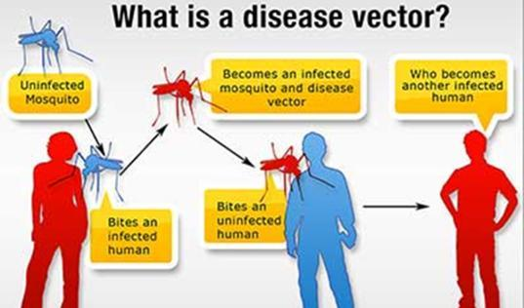
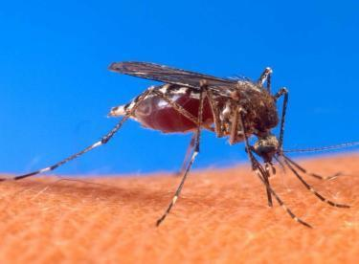
WASH and Vector-borne diseases
WHO estimates that malaria kills over 400 000 people every year – mainly children under 5 years old
Source: CDC
Photo: USDA
Notes:
Key talking points:
Vectors are living organisms that can facilitate/transmit infectious diseases between human or from animals to humans. Many of these vectors are bloodsucking insects that ingest blood from an infected host (human or animal) and later inject them into a new host during their next blood meal.
Insects vectors such as mosquitoes and flies usually breed in water, bite near water and proliferate in dirty environments
An increase in temperature can increase mosquito development: mosquitoes/larvae could develop faster, fly further, survive longer and bite more. High temperatures can also increase mosquito mortality as mosquitoes live shorter times at significantly higher temperatures. However, the vast majority of those changes allow mosquitoes to be more effective vectors.
Climate change may change the temporal and spatial patterns of vector-borne diseases. This means that vector borne diseases are projected to expand their geographical areas where they occur, as new areas become suitable for mosquito development, and disease establishment. For example, mosquitoes are typically found in the lower altitudes but with temperature variations, they could reach higher elevations which were historically too cold for the disease. E.g malaria transmission seen in highlands of kenya.
This is particularly worrisome because the populations that are newly exposed to an infectious disease may lack premunity (anticipatory immunity that prevents severity of disease) to that disease which could result in larger and/or more severe outbreaks.
According to WHO, “malaria seems likely to be the vector-borne disease most sensitive to long-term climate change as increased rainfall, humidity and temperature can enhance mosquito breeding and survival”. Other vector-borne diseases might be impacted as well such as dengue, Zika, Chikungunya, Lyme, yellow fever, etc.).
Additional information for the moderator:
There are also other vectors than mosquitoes, such as rats that plague and leptospirosis.
The WHO estimates that 60 000 additional people will die from malaria every year between 2030 and 2050 because of climate change.
How many people are at risk of getting dengue? How many infections do we see annually?
ANSWER: Each year
* 3.9B people at risk of dengue
* 390M infections
* 500k hospitalizations
* 2,5% die from the infection
The distribution of dengue is highly dependent on climate: warmer temperatures, higher humidity and more places where water can collect generally favour dengue transmission. In the IPCC's 1.5 degree warming report (Intergovernmental Panel on Climate Change 2018), they state: Risks for some vector-borne diseases such as malaria and dengue fever are projected to increase with warming from 1.5°C to 2°C, including potential shifts in their geographic range (high confidence). Overall for vector- borne diseases, whether projections are positive or negative depends on the disease, region and extent of change (high confidence).
Increased levels of rainfall or flooding means that water collects in stagnant pools which provides conditions for mosquito breeding and therefore the risk of spreading dengue fever.
Low rainfall can also increase infection rates as people store more water at home and these containers provide breeding sites.
Image
https://www.cdc.gov/nceh/ehs/elearn/vcehp.html

Slide 19
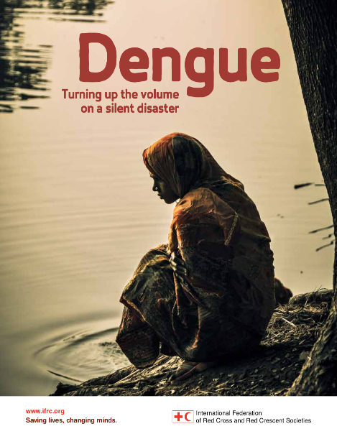
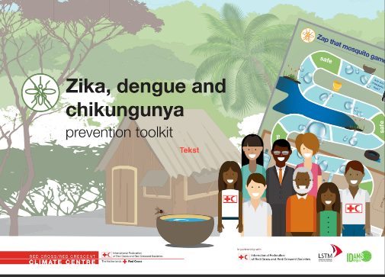
Dengue fever continues to get worse with no end in sight
Notes:
Cases of dengue fever have risen dramatically in the last 40 years. This is primarily caused by unplanned urbanization with increased standing water in waste areas, and by movement (global travel) of people and goods. This has spread both mosquito vectors and infections.
Zika toolkit: https://drive.google.com/open?id=0B1b032MNqXGAUEFrakJoZklCanM
Dengue – turning up the volume: https://www.ifrc.org/dengue#:~:text=The%20IFRC%20is%20turning%20up,leading%20to%20sustainable%20behavioural%20change

Slide 20
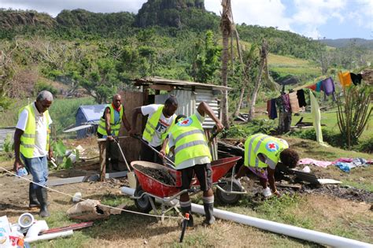
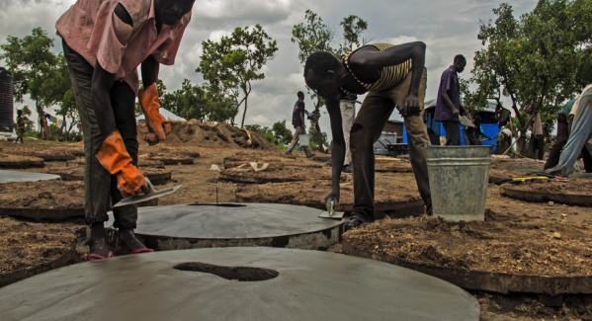
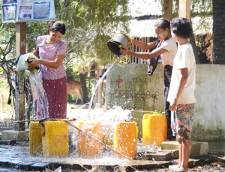
Sanitation and climate change
Photo: IFRC
Photo: Myanmar RC
Photo: IFRC
Notes:
Interaction: Can you guess what are the 2 main types of health consequences of climate change related to sanitation?
Talking points:
The WHO recommends "universal access to toilets that safely contain excreta".
Sanitation infrastructures are vulnerable to the impacts of climate change such as floodings, droughts, storms / cyclones, sea-level rise or even higher-temperature.
As for other sectors, the effects of climate change on sanitation varies greatly across population groups and is more likely to affect poor and marginalized communities. According to the IPCC climate change is expected to exacerbate existing health problems including those related to poor sanitation (IPCC, 2014c).
Climate change-related health consequences from sanitation systems generally fit within two overarching categories: (i) increased risk of disease or illness from exposure to pathogens and hazardous substances through increased environmental contamination, and/or (ii) increased risk of disease or illness resulting from a lack of access to adequate sanitation when systems are destroyed or damaged.
Additional information for the facilitator - Source: WHO - Climate, Sanitation and Health
Sanitation workers may experience additional risks depending on their work context and level of occupational health and safety.
Management of the physical risks created by existing climate hazards can be an effective first-step in an adaptation strategy.
Images sources:
1- IFRC
https://media.ifrc.org/ifrc/what-we-do/health/water-sanitation-hygiene-promotion/
2- Myanmar RC https://www.redcross.org.mm/en_US/what-we-do/water-and-sanitation-hygiene-promotion/
3- IFRC https://media.ifrc.org/ifrc/2017/11/19/tackling-disease-outbreaks-toilets-worlds-fastest-growing-refugee-camp/
More info on the effects of climate change on sanitation:
* More intense or prolonged precipitation: E.g. Greater rainfall in an event potentially creates more frequent or more intense flooding that can disrupt faecal sludge management (FSM) services if roads and access to containment and/or treatment plants are blocked, result in sewage overflows, and exceed the intake capacity of wastewater treatment plants.
* More variable or declining rainfall or run-off: E.g. Longer dry periods can lead to a decline in water supply that impedes the functioning of water-reliant sanitation systems, for instance concerning flushing toilets or blockages due to low sewer flows. High variation in rainfall can cause ground movement in soils with high clay content, resulting in pipe damage for sewer conveyance. Drier conditions can also have a beneficial effect of attenuating the flow of pathogens into water sources.
* More frequent or more intense storms or cyclones: E.g. Storms can damage or destroy latrine superstructures, conveyance pipes, power supplies etc, potentially resulting in increased slippage to open defecation and disruptions to pumping and treatment facilities.
* Sea-level rise: E.g. Rising sea-levels and consequent salinization can expose coastal wastewater treatment plants and other sanitation infrastructure to inundation and corrosive saltwater.
* More variable and increasing temperatures: E.g. Higher water temperatures can be conducive to the proliferation of algal blooms and compound the effects of sanitation pollution in freshwater. Higher temperatures can also have a beneficial effect of increasing the efficiency of biological processes in wastewater treatment.

Slide 21
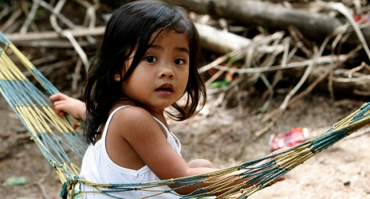
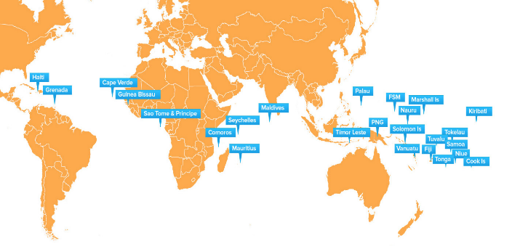
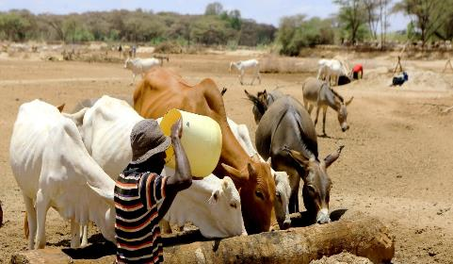
The most vulnerable
Photo: IFRC
Source: UNDP
Photo: D. Onyodi/KRCS
Notes:
Interaction: Can you think of populations or places that are particularly vulnerable to the health consequences of climate change?
Key talking points:
· Climate change does not affect everyone in the same way.
· Impacts depend on exposure, vulnerability and adaptive capacity
· Here are the main categories (Adapted from IPCC - Chapter 11. Human Health - Impacts Adaptation and Co-Benefits – 2014)
1-Geographic causes of vulnerability: areas vulnerable to sea-level rise and flooding, people living in citify are more susceptible to heatwave, rural populations relying on farming for subsistence are at higher risk of undernutrition and water-related diseases in case of drought.
2-Age, gender, current health status: Children and older adults are at higher risk of climate-related injuries and diseases (ex: elderly people are vulnerable to heatwaves or floods, children are more susceptible to diarrhoea and malnutrition). Gender disparities can vary depending on climate risks (ex: in Bangladesh, women were found to die during a flood, but in China, men were found to be more likely to die from flooding because of higher exposure through rural farming). Pre-existing health conditions such as diabetes, high blood pressure, mental health issues etc. are also vulnerability factors in the context of climate change.
3-Socio-economic status: “the poorest countries are generally the most susceptible to damage caused by climate extremes and climate variability”, even though they are not contributing much to climate change. “In many countries, race and ethnicity are powerful markers of health status and social disadvantage”. For example, indigenous people who depend heavily on natural resources are at higher risk of economic loss and poor health as a result of climate change.
4-Access to healthcare facilities and other infrastructure: people who do not have access to quality health services or to a health coverage are more likely to be negatively affected by climate change. Lack of access to safe water is also a vulnerability factor in the context of climate change.
Additional information for the moderator:
"Climate justice “insists on a shift from a discourse on greenhouse gases and melting ice caps into a civil rights movement with the people and communities most vulnerable to climate impacts at its heart,” said Mary Robinson who is no stranger in the world of politics and human rights" (Source: un.org)
"While many developing countries emphasize the historical responsibility of the developed world when it comes to GHG emissions, many developed countries have remained reluctant to bear the full burden of climate responsibilities. From this, the concept of climate justice has emerged, stressing that climate change is an ethical and political issue as well as an environmental and physic alone" (Source: UN - World Water Development Report 2020 - Water & Climate Change)
Women and girls are exposed disproportionately to risks of waterborne diseases during floods due to a lack of access to safe water, the disruption of water services and increased contamination of water resources.
Image source:
UNDP: https://www.adaptation-undp.org/projects/undp-sids

Slide 22
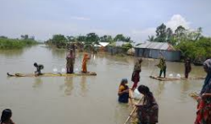
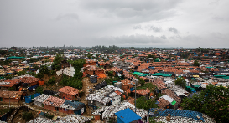
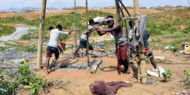
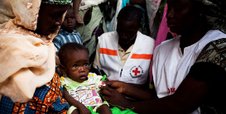
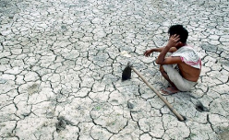
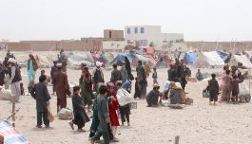
How do vulnerability factors exacerbate the negative effects of climate change on health?
Drowning, injury, death
Repeated diarrhoea
Mental health disorders, conflict, migration
Photos: IFRC
Notes:
Interaction: What are the determinants of risk? Can you give an example of how vulnerability to a health impact be reduced?
Key talking points:
"Risk is determined not only by the climate and weather events (the hazards) but also by the exposure and vulnerability to these hazards" (IPCC - Chapter 2. Determinants of Risk - Exposure and Vulnerability - 2014).
Social determinants of health are affecting the level of risk that people face: those determinants make them more or less exposed to a climate change hazard or more or less vulnerable to that hazard.
According to the WHO, “The social determinants of health (SDH) are the conditions in which people are born, grow, work, live, and age, and the wider set of forces and systems shaping the conditions of daily life”. Examples of social determinants of health include race, gender, professional, geographical location, etc.
Here are a couple of examples to illustration how a climate change-related hazard + vulnerability criteria can result in increased negative health impacts:
Example 1, direct impact of climate change: Increased frequency and severity of floods etc. + Unsafe housing = Increased risk of drowning, injury or death.
Example 2, impacts mediated through natural systems: Food and water contamination + Lack of access to food or safe water = Increased risk of repeated diarrhoea.
Example 3, impacts mediated through socio-economic systems: Water scarcity + Living in a conflict-affected area = Increased risk of conflict, migration and mental health disorders.
The examples are presented here in a schematic way, but they are actually interconnected. For example someone living in an unsafe housing might be at higher risk of death an injury in case of a natural disaster, but might also lack access to safe water and be more exposed to diarrheal risks resulting from drought or from water contamination.
Additional information for the moderator - Sources: IPCC - Chapter 2. Determinants of Risk - Exposure and Vulnerability - 2014.
"Hazard refers to the possible, future occurrence of natural or human-induced physical events that may have adverse effects on vulnerable and exposed elements". Hazard is a component of risk, it is not risk itself. It can be increase by human activities and climate change (ex: higher hazard of flooding in areas that have been deforested).
"Exposure refers to the inventory of elements in an area in which hazard events may occur". For instance the exposure is not similar if the hazard happens in a very populated city or in a desert.
"Vulnerability refers to the propensity of exposed elements such as human beings, their livelihoods, and assets to suffer adverse effects when impacted by hazard events". Some examples of vulnerability factors are listed above.

Slide 23
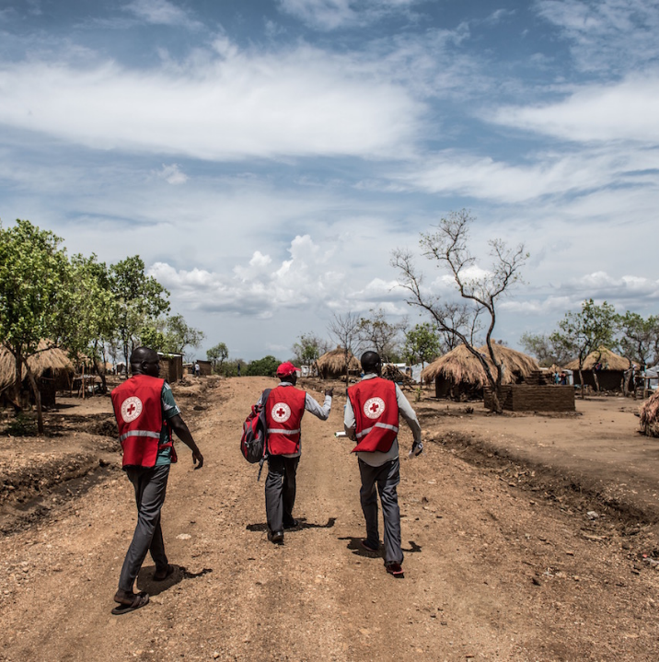
Part II What can we do to reduce the health risks associated with WaSH and climate change?
Pixabay
Notes:
Interaction: What do you think about as potential action to reduce health risks associated with WaSH and climate change?
Have you taken part in any of project related to that?
This question could be first posed as an open question to the audience to gather their thoughts.

Slide 24
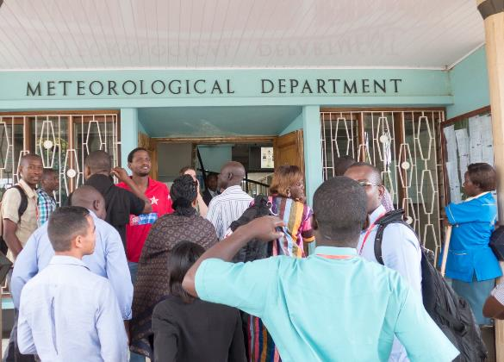
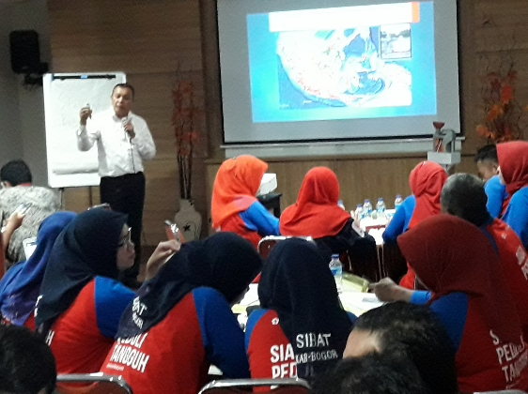
National HydroMet services and national public health authorities – our key partners
Notes:
Interaction: Is anyone in touch with the HydroMet services of their country? with the health authorities? Would you like to share your experience?
Key talking points:
In order to conduct a risk assessment it is necessary to start with whatever is currently known about changes to weather and climate and possible changes in the future:
Check if your National Society has worked on a climate change background document as part of the ‘Preparedness for Climate Change’ programme (over 60 countries had participated by the end of 2011) – this may contain useful information.
Find out if someone in your National Society is in contact with the national meteorological office and/or environment department. If not, you could make an effort to establish the relevant collaboration. In module 1 there is a guidance note on how to engage with the local weather forecasts / early warning systems / water, hydrological and climate (or “hydromet”) services. It provides good tips and hints for this dialogue and partnership development.
These offices will be able to provide an overview of historical changes (eg. rainfall patterns for a given town) that are already occurring, plus projected climate for the coming decades (eg. increasing drought for a given country). The historical trends information could be available for specific locations.
However it is important to note that projections for the future are not available accurately at local scale (downscaled models don’t agree with each other) and therefore can’t be used for guiding site selection or to help identify site-specific adaptation measures.
Good to ask the Met office if they have specific information relevant for disease outbreak patterns in the country or any historical data on this.
The NS should also engage a dialogue with health authorities to have access to information on disease outbreak and other health consequences of climate change.
REMEMBER THIS IS AN ITERATIVE PROCESS- risks, vulnerabilities and impacts are dynamic and evolve with time!
Additional information for the moderator:
Please see "Collaborating with national climate and weather agencies: a guide to getting started"
https://www.climatecentre.org/downloads/files/1a.%20Collaboration%20with%20Met%20Agencies.pdf

Slide 25
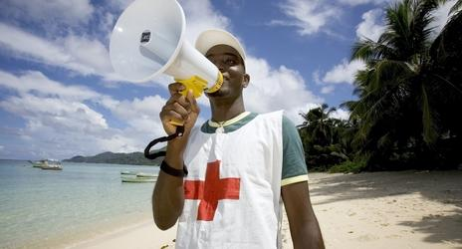
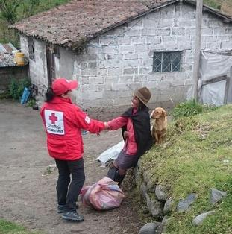
Early Warning, Early Action
Anticipate, reduce and prepare for changing risks
Effective early warning, enables early action
Early action reduces human loss and suffering, and economic losses
Early action can protect development gains
Photo: IFCR
Photo: IFCR
Photo: Ecuador Red Cross
Photo: Ecuador Red Cross
Notes:
There are many reasons to undertake EWEA, key ones are highlighted in this slide.
Climate and weather information can help anticipate, reduce and prepare for changing risks. It important to note that climate-related changes are different from from weather-related changes: changing vector patterns are not just related to storms, but may be a permanent new feature (ex: malaria-carrying mosquitos moving into higher altitude communities that weren't previously exposed). Health promotion needs to take into account predicted health risks for early identification and early action, not just the current health risks.
Having effective early warnings, enables early action.
Taking early action can reduce human suffering and economic losses.
Taking early action can protect development gains through reducing the impact of hazardous events.
Additional information for the moderator:
For further information, please consult Module 2a: “EWEA - steps to make it happen”; “EWEA in the Red Cross Red Crescent - Introduction”

Slide 26
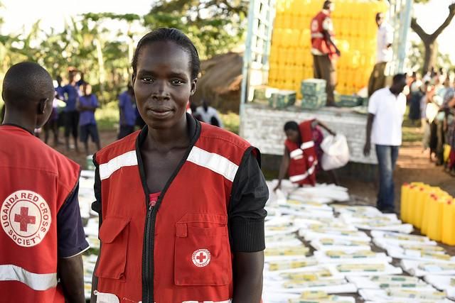
What is Forecast-based Financing?
A mechanism that enable access to funding for early action based on credible forecast and in-depth risk analysis
Photo: D. Onyodi / URCS
Notes:
FbF in the RCRC emerged in recent years as a response to the lack of action before disasters, bearing in mind that there are tools that can allow decision makers and disaster risk managements to do something to minimize risks and prepare for effective response. The first attempt to allocate funds based on a Forecast was in 2008 in West Africa, based on a seasonal forecast. Since then the Red Cross Red Crescent has developed further the FbF approach. Having established an Anticipatory Fund that all National Societies can have access to when they have FbF Early Action Protocols and having develop the expertise to established those protocols.
In the next 2 slides the facilitator will find an explanation about “what Early Action is in the context of FbF” and What does it mean to be able to access funding based on forecast and risk analysis”
A Forecast based financing systems address extreme events.
Additional information for the moderator:
For further information, please consult Module 2a: “Forecast based financing - Basic”; “2a Forecast based Finance - Advanced”; “2a Understanding Forecasts for Early Action”

Slide 27
Climate-smart WaSH programming
Climate-smart programmes and initiatives strengthen peoples’ awareness and incorporate climate and weather information in assessing and addressing climate risks and vulnerabilities. It enables ‘early warning early action’, and empowers people to anticipate, absorb and adapt to climate shocks and changing risks.
No stand-alone programming, but modifying what we already do or influencing existing systems or schemes
Cross-cutting and cascading risks: climate change needs to be considered alongside other risks (health, environmental risks, ecosystem degradation, etc)
How does the wider landscape ("upstream”) affect risks in this community?
Photo: K. Falk / Danish Red Cross
Notes:
Checklist for preparing a WASH program from a climate perspective (provides examples of both mitigation and adaptation)
Interaction: has anyone heard of "climate-smart"? can someone explain or guess what it means?
Could you give an example of what you think would be considered a climate-smart program?
Talking points:
Climate-smart programming equates simply to ‘good programming’ and development, enabling people to anticipate, absorb and adapt to climate shocks and stresses by using climate information across timescales, considering landscapes and ecosystems as key areas of intervention – all in close collaboration with governments, specialists and the private sector.
When it comes to the WaSH sector, climate-smart (or "climate resilient") program need to focus on: 1) "A reduction in the likelihood that individuals feel the effects of climate change and related shocks", 2) "Strengthening the reliability of WASH services", 3) "Strengthening capacities of governments and communities to increase climate resilience overtime" (UNICEF - WASH Climate Resilient Development)
Example of climate-smart WASH adaptation interventions, see in the next slides.
Understand and monitor impacts and think about how non-health sectors affects health (cf. co-benefits)
Vice President Maledives Red Crescent - Aisha Niyaz - Vice President, Governing Board- ideas how that can work in Maldives - give her the floor.
Who believes they have really great examples already in the room or really good plans.
There are many risks that any given community may face and these risks may be different from one community to a next.
They could be related to health, land tenure, agriculture or livelihoods.
→ Keep this?
Additional information for the moderator
"Climate-smart" is a term that was first used for agricultural programs to achieve 3 main objectives: "sustainably increasing agricultural productivity and incomes; adapting and building resilience to climate change; and reducing and/or removing greenhouse gas emissions, where possible" (FAO)
When it comes to the Health & WaSH sectors, it refers to interventions or facilities that are both climate-resilient and low-carbone (address both adaptation and mitigation) (World Bank)
→ That definition is different from the one use by the Climate Centre: do climate-smart interventions within the RC/RC movement also have a mitigation component?

Slide 28
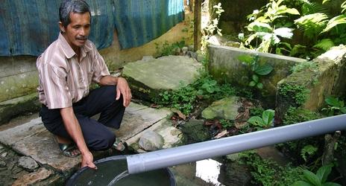
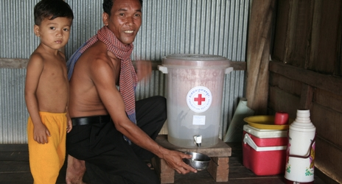
WaSH adaptation interventions – water management
“Water can help fight climate change. There are sustainable, affordable and scalable water and sanitation solutions”
Harvesting rainwater
Reusing wastewater
Promote underground water storage
Protect investment in ground water
Photo: IFRC
Photo: IFRC
Notes:
Key talking points:
“Water can help fight climate change. There are sustainable, affordable and scalable water and sanitation solutions.”
Here are some examples of climate-smart WASH interventions
Harvesting rainwater. Rainwater capture is particularly useful in regions with uneven rainfall distribution to build resilience to shocks and ensure supplies for dry periods. Particularly effective in areas where water sources are unreliable or not available. Can be collected through rooftops to provide households with water to drink or use for irrigation purposes. It also reduced the time spent fetching water which can be spent on education, social activities or otherwise.
Reusing wastewater. Unconventional water resources, such as regulated treated wastewater, can be used for irrigation and industrial and municipal purposes.
Promote underground storage to minimize loss of water supply from excessive evaporation.- for households and also for community water supplies.
Protect investment in ground water by using tested ground water exploration methods. Invest in ground water monitoring to understand seasonal variations and to avoid long-term over-extraction.
Those interventions are “no regret” solutions, meaning that they have benefit regardless of whether certain predicted climate change impacts are realized. These measures may not necessarily be targeted at a specific hazard, but help to increase resilience to shocks at large – for instance by strengthening community livelihoods and capacities.
Rainwater harvesting in Cambodia: https://www.ifrc.org/en/news-and-media/news-stories/asia-pacific/cambodia/a-gift-from-the-skies-rainwater-harvesting-in-rural-cambodia/?print=true

Slide 29
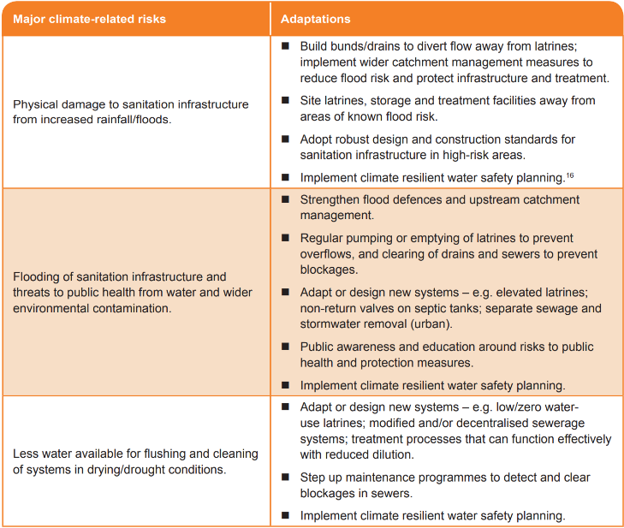
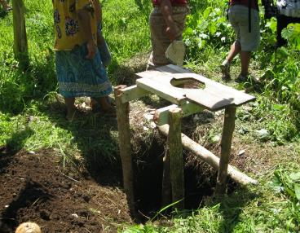
WaSH adaptation interventions – sanitation
Photo: IFRC
Source: Unicef – Global Water Partnership 2017
Notes:
More examples of climate-smart sanitaiton interventions
Use local knowledge/ hydrological data in sitting latrines /water supply services in close proximity to water bodies. Have clear understanding of lateral and vertical ground water flows during locating of sanitation facilities such as latrines, soakaway pits.
Diversify technology use such as ecological sanitation in areas prone to water logging. Latrines/sanitation facilities in water logged conditions may require much higher investment per capita. Latrines/sanitation facilities in water logged conditions may require much higher investment per capita. Latrine adaptation: Pit latrines can be adapted to reduce their vulnerability to floods and rising groundwater (ex: latrines can be raised on mounds, or be emptied regularly). Cheap and basic option but not suitable in areas that are prone to constant flooding
Design storm and waste water sewers based on expected max flows to ensure such infrastructure is protected against damage. It is to be noted that climate change is projected to cause more frequent and more extreme weather events, therefore maximum flows should not only be estimated based on historical data but also on future projections.
https://www.gwp.org/globalassets/global/about-gwp/publications/unicef-gwp/gwp_unicef_linking_risk_with_response_brief.pdf

Slide 30
Case study –Mali
Strengthening the capacity of the Mali Red Cross to respond and prevent cholera outbreaks
A: Construction of safe water and sanitation facilities
B: Training of volunteers, government staff and NGO coordinators based in cholera hotspot areas in:
Prevention
Setup of oral rehydration points (ORP)
Household filters
Construction of safe water sources and sanitation facilities
Photo: Mali Red Cross
Notes:
Construction of safe water and sanitation facilities train volunteers, Mali Red Cross staff, government staff and NGO coordinator based on cholera hotspots in prevention and the setup of oral rehydration points (ORP), household filters , construction of safe water sources and sanitation facilities.
Technical support to train 15 volunteers, 6 Mali Red Cross staff, 3 government staff and an NGO coordinator based in Koulikoro on cholera prevention and the setup of oral rehydration points (ORP). The training was followed by a cholera simulation to test roles, responsibilities and coordination mechanisms. Lessons learnt during the simulation will inform the revision of the Mali Red Cross contingency plan. Positive feedback was received from government partners and WHO who participated in the simulation and expressed interest in strengthening their relationship with the Mali Red Cross to prepare for and respond to outbreaks.

Slide 31
Case study - Indonesia
Working with local communities to limit dengue transmission
Volunteers engaged in community-based surveillance identified a growing number of dengue cases – then to break the chain of dengue transmission:
Home visits are accompanied by monitoring mosquito larvae in water reservoirs
Provision of Abate powder (to limit insect outbreak) to the communities
Fogging – indoor insectide spraying
Information sharing about symptoms, and how to get support, and the importance of a clean environment.
Photot: Indonesian Red Cross (PMI)
Notes:
As part of the Community Epidemics Pandemic Preparedness Program (CP3 programme), the Indonesian Red Cross continues efforts to curb the spread of dengue fever in Tabanan Regency in Bali.
Volunteers engaged in community-based surveillance have supported the identification of a growing number of dengue cases in the area for the past few months.
Home and small business visits are accompanied by activities to monitor mosquito larvae in water reservoirs, the provision of abate powder to the communities, and fogging to break the chain of dengue transmission.
By involving volunteers, youth and neighborhood groups, the Red Cross shares information about the symptoms of the disease, how to get support if feeling sick, and the importance of a clean environment.
Note: Abate powder is a brand name: when applied to standing water where mosquitoes and other insects breed, Abate kills the larvae before they develop into mature insects

Slide 32
Part III Available tools & resources
Pixabay
Notes:
What do you think about as potential action to reduce health risks associated with WaSH and climate change?
This question could be first posed as an open question to the audience to gather their thoughts.
https://www.unwater.org/publications/world-water-development-report-2020/
https://www.unwater.org/publications/climate-change-adaptation-pivotal-role-water/
https://www.unicef.org/wash/files/Strategic_Framework_WEB.PDF
https://www.who.int/water_sanitation_health/publications/climate-resilient-water-safety-plans/en/
https://www.who.int/publications-detail-redirect/climate-sanitation-and-health
http://www.fao.org/3/i2096e/i2096e00.htm

Slide 33
Climate-resilient water safety plans
Notes:
Note for the moderator: This slide should be presented briefly and anyone who has interest in learning more should be invited to consult the guide.
Link:
https://www.who.int/globalchange/resources/wash-toolkit/en/
WHO resources on Climate Change, WASH and Health are available online, they include guidelines, case studies, trainings, etc.
WHO - Climate Resilient Water Systems, 2018
In the face of such anticipated climate change impacts, there is a need to improve the climate resilience of water supply services to cater for extreme weather conditions, increasing resource stresses and ensuing water quality and quantity issues. Water safety plans (WSPs), which constitute a proactive and comprehensive risk assessment and risk management approach to ensure the safety and security of drinking-water supplies, provide a valuable framework to address these issues.
To strengthen climate resilience through the WSP process, it is important to understand current and future risks posed by climate variability and change, which are often similar across a climatic or ecological zone. WSPs at the local scale could therefore benefit from the assessment of the vulnerability of water resources at a regional scale. This is why the WHO recommends conducting a regional climate vulnerability assessment to provide inputs into the WSP process.
For example, meltwater from glaciers in the Himalayas contributes significantly to river systems and water resources in much of South Asia. For a water utility preparing a WSP, it is important to understand how this source of water may be affected by climate change on a regional scale. A regional climate vulnerability assessment may address such questions as: Will the seasonal pattern of river flows be affected? If glacial melt increases, will the availability of water increase in the short term? If glaciers continue to melt and retreat, will this reduce water resources in the longer term?
As climate risks to water supply systems manifest through both increased frequency of extreme events and long-term stresses on water resources availability and quality, two complementary approaches are relevant and should be considered through the WSP process. Disaster risk reduction (DRR) focuses on mitigating exceptional events, principally through improving resilience; and integrated water resources management (IWRM) provides a framework for adaptation to the long-term changes associated with climate change.
How to integrate climate change into a WSP Process?
1 - Seek additional expertise: The WSP team normally consists of water supply system operators, managers and technical specialists, and often representatives from the health and environmental sectors. However, to consider and address the effects of climate change, WSP teams may require additional support in obtaining and interpreting climate-related information (climatologist, hydrologist, public health specialist, DRR expert, etc.)
2 - Describe the water supply system: consider current and future (projected) conditions that have the potential for climate-related impact on water resources or the water supply system infrastructure (e.g. gather information on historical and projected data on source yield, water quality, extreme weather events, land use, population growth, etc.)
3 - Identify hazards and assess risks: The risk associated with a hazard or hazardous event is a combination of the likelihood of the hazard or hazardous event occurring (over some time frame) and the severity of the consequences of the hazard or hazardous event if and when it occurs. Both the likelihood and the severity of the consequences arising from the hazard are likely to change due to climate variability and change (e.g. climate events affecting water availability & quantity, water infrastructure). This also includes assessing the impact of climate change on control measure effectiveness (considering existing control measures that are already in place to manage each hazardous event and validating the effectiveness of those control measures in the context of climate change)
4 - Improvement planning: Identify additional control measures to manage climate-related risk (cf. "low regret" or "no regret"measures" that deliver benefits under a wide range of possible futures).
Control measures supporting water quality (minimize manure and sewage runoff from catchment, provide additional treatment to control pathogens, mi
Control measures and improvements supporting water availability and reliability (demand-side options: reducing levels of risks by decreasing water consumption, enhancing efficiency / supply-side options: increasing source yield, developing new sources)
Consider the impacts of climate change on long-term plans (e.g. designing adaptable infrastructure to cope with climate-change related uncertainty, diversify water sources, influence water demand, etc.)
5 - Management procedures and supporting programs: A WSP should include preparedness for incidents, disasters and extreme events. By integrating relevant types of disasters and their potential consequences into a WSP, the WSP can contribute to DRR through better preparedness and contingency planning to facilitate water safety in an emergency as well as faster recovery of normal functions after an event.
Include climate risk management in supporting programmes: build the institutional and individual capacity of water suppliers to manage risks associated with water scarcity and reliability in addition to water quality risks.

Slide 34
UNICEF, Global Water Partnership - WaSH Climate Resilience
www.gwp.org/en/WashClimateResilience
Pixabay
Notes:
Link:
https://www.gwp.org/en/WashClimateResilience/
That website offers technical documents for the different phases of the project as well as training materials.
It was developed by the Global Water Partnership and UNICEF.

Slide 35
washmatters.wateraid.org/climate-change
Notes:
An open question to the audience to gather their thoughts: "What do you think about as potential action to reduce health risks associated with WaSH and climate change?"
The website offers many reports and tols: washmatters.wateraid.org/climate-change

Slide 36
The central role of water
Notes:
Talking points:
"Access to clean water and sanitation" is listed as a specific Sustainable Development Goals, but it is also essential to many other sectors, including health, agriculture, livelihoods.
"Although water is not mentioned in the Paris Agreement per se, it is an essential component of nearly all the mitigation and adaptation strategies" (UN - World Water Development Report 2020 - Water & Climate Change)
"While water is seldom mentioned in the Sendai Framework itself, floods and storms account for nearly 90% of the most severe natural disasters (Adikari and Yoshitani, 2009)"
This graph help understanding that water should not be considered as an isolated sector but rather as a connector and a facilitator to achieve sustainable development goals, climate change adaptation and disaster risk reduction.
Water s at the heart of our well-being.
Image Souce: UN-Water (2019) - Can be adapted into a different graph if the text is too small.
Additional information for the facilitator - Source: UN - World Water Development Report 2020 - Water & Climate Change
The Sustainable Development Goals are a universal call to action to end poverty, protect the planet and improve the lives and prospects of everyone, everywhere. The 17 Goals were adopted by all UN Member States in 2015, as part of the 2030 Agenda for Sustainable Development which set out a 15-year plan to achieve the Goals.
While "access to clean water and sanitation", it is interconnected with many other goals such as "access to health", "preservation of marine life", "gender equality", "zero hunger", "no poverty", "climate action", etc.
On the other hand, through the Paris Agreement adopted in 2015, countries have committed to “holding the increase in the global average temperature to well below 2°C above pre-industrial levels and pursuing efforts to limit the temperature increase to 1.5°C above pre-industrial levels, recognizing that this would significantly reduce the risks and impacts of climate change” (UNFCCC, 2015, Article 2).
Although water is not mentioned in the agreement per se, it is an essential component of nearly all the mitigation and adaptation strategies. Most identified hazards are also water-related, such as floods, droughts or sea-level rise.
In 2015, UN Members also adopted the Sendai Framework for Disaster Risk Reduction 2015–2030, commonly referred to as the “Sendai Framework”. This is a non-binding framework aiming at "the substantial reduction of disaster risk and losses in lives, livelihoods and health and in the economic, physical, social, cultural and environmental assets of persons, businesses, communities and countries” (UNDRR, 2015a). This agreement marks an important shift from disaster relief to prevention.
While water is seldom mentioned in the Sendai Framework itself, floods and storms account for nearly 90% of the most severe natural disasters (Adikari and Yoshitani, 2009). Those disasters are highly sensitive to the impacts of climate change.
This graph help understanding that water should not be considered as an isolated sector but rather as a connector and a facilitator to achieve sustainable development goals, climate change adaptation and disaster risk reduction.
Placing water at the heart of these strategies is an essential way forward and would help the water community deliver its message to the climate community and a broader audience (UN-WWDR).

Slide 37
No regret solutions
Notes:
Interaction: has anyone heard of "no-regret solutions"? can someone explain or guess what it means?
Could you give an example of what you think would be considered a "no-regret solutions"?
Talking points:
"No-regrets" policies and actions are measures that have benefit regardless of whether certain predicted climate change impacts are realized (FAO - Climate Change, Water and Food security, 2011)
In many locations, there is high uncertainty about the precise changes that global climate change will cause in local weather. In such a case, no-regrets measures that focus on strengthening overall resilience and reducing vulnerability should be considered. These measures may not necessarily be targeted at a specific hazard, but help to increase resilience to shocks at large – for instance by strengthening community livelihoods and capacities.
An example of a "No-regret" action is scheduled emptying of latrines in advance of flood seasons (WHO - Climate, Sanitation and Health, 2019)

